Slide 1
Gaussian Blur Different Parallel Platforms Comparison
Group No. 24
0756031 資工所 李鴻暘
0416324 資工系 胡安鳳
0416024 資工系 陳羿豐

Slide 2
Outline
Gaussian Blur explained.
Motivation.
Environment for this project
Parallelization platform animation.
Different platforms explained and respective discoveries .
CUDA
OpenCL
OpenMP
Demo video.
Q&A

Slide 3
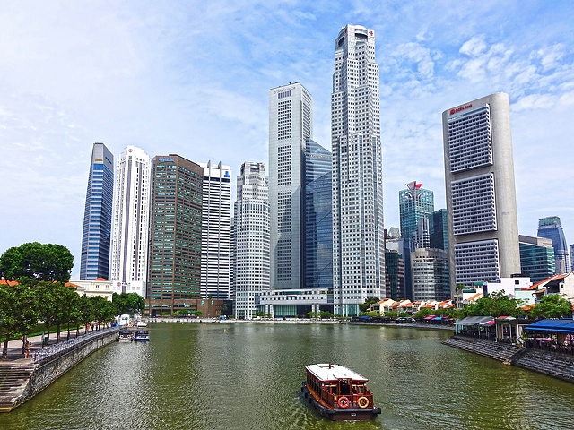

What is Gaussian Blur and why need?
An image processing algorithm using convolution to smooth images.
Result images varies with filter size and standard deviation of Gaussian Kernel.
Such algorithm can be used for noise reduction of the image.
Time complexity is O(img_width x img_height x filter_size^2)
640 x 480
filter size 101 x 101
stddev 10

Slide 4
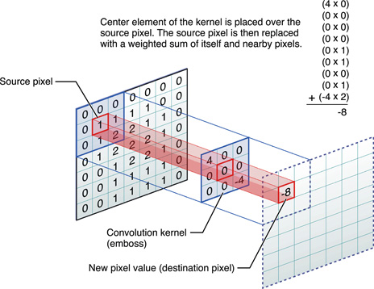
Motivation of this project
Widely used algorithm in lots of software like PhotoShop, GIMP.
Due to convolution, the compute complexity is extremely high.
Beside the well-known POSIX thread ,with an eye to try parallel on OpenMP where both computes with CPU.
Heterogeneous computation: Use more than one kind of processors, co-processing to gain significantly performance improvement such as CUDA and OpenCL
Gaussian Convolution with its kernel
Img source

Slide 5

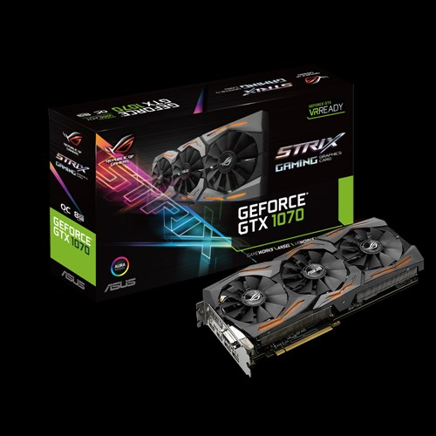


Environment for this project
Intel i5 7500 4C4T
3.4GHz
ASUS STRIX GTX1070 OC 8GB
1920 CUDA Cores
Samsung PM981
512G (970 EVO
Equivalent)
Ubuntu 16.04 x64
Images source from respective company

Slide 6
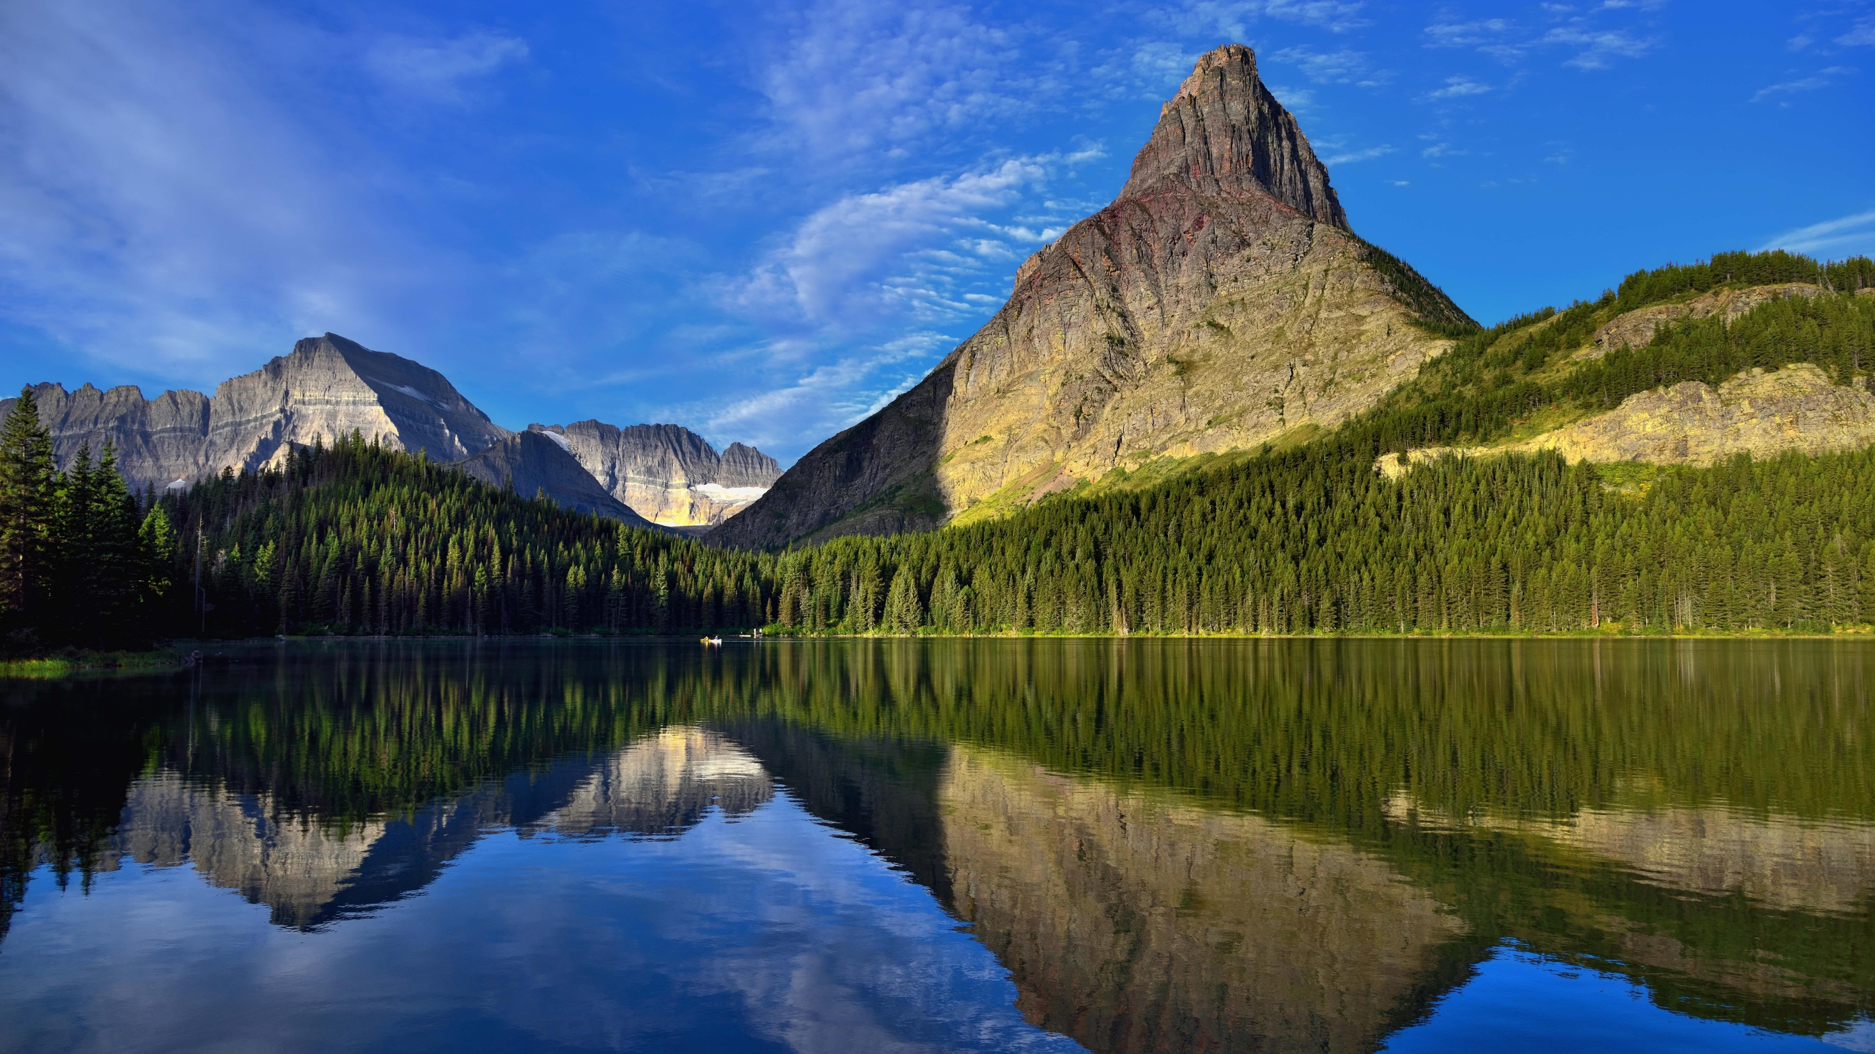
Benchmark method
8K(7680 x 4320) image for processing
Filter size fixed to 101 x 101
Use Linux command: $time ./obj_file to measure execution time
Computation is 338444697600 (338 billion!)
Check error percent if needed (diff image)
Baseline
Serial time is 82m44s (4964s)
POSIX thread time

Slide 7
How we parallel (animation)

Slide 8
Compute Unified Device Architecture
Using 1024 thread per block (i.e.)
Each thread deal with one pixel.
Compare pixel-wise(R G B) to verify the correctness due to GPU precision slightly inaccurate.

Slide 9
Thread per block vs performance

Slide 10
CAN WE DO FASTER?

Slide 11
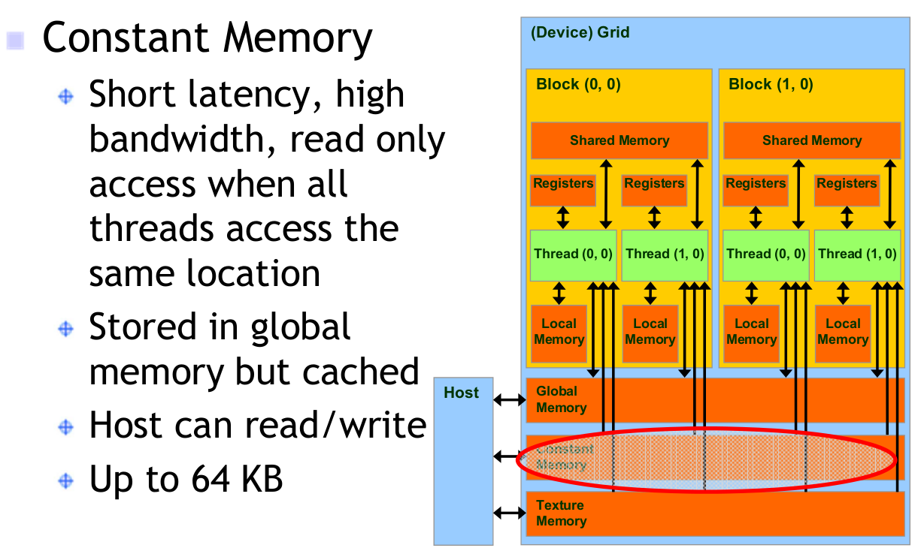
Do faster with Constant Memory
Filter is frequently and repeatedly accessed but GPU global memory is quite slow.
Use the __constant__ identifier to declare the variables as constant

Slide 12
標題及含圖表的內容版面配置

Slide 13
含表格的兩項內容版面配置
第一個項目符號
第二個項目符號
第三個項目符號
類別 | 群組 1 | 群組 2
類別 1 | 82 | 95
類別 2 | 76 | 88
類別 3 | 84 | 90

Slide 14
含 SmartArt 的兩項內容版面配置
第一個項目符號
第二個項目符號
第三個項目符號
工作 1
工作 2
工作 3

Slide 15
新增投影片標題 - 1

Slide 16
新增投影片標題 - 2

Slide 17
新增投影片標題 - 3

Slide 19
新增投影片標題 - 4

Slide 20
新增投影片標題 - 5

